Slide 1
76
Discrete Mathematics
Introduction to Graphs

Slide 2
















Slide 3




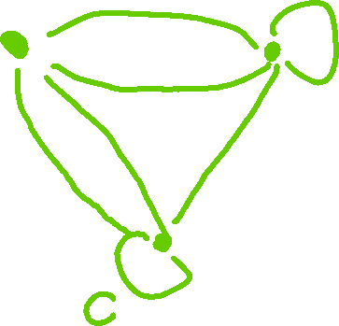





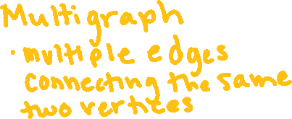




Slide 4






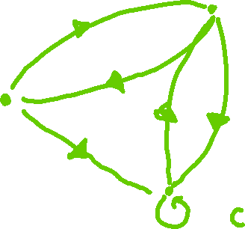
















Slide 5













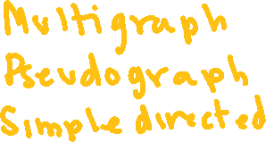



Slide 6
Up Next…
Graph Terminology

